Slide 1
HUDUMA CHAPCHAP
Fourth Impact, Technovation

Slide 2
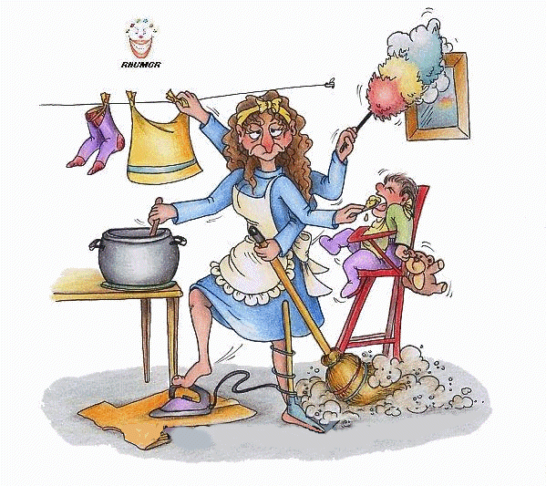
WHY?
Sometimes we’re overwhelmed, and we desperately need help.
Helpers are everywhere, but how can they know we need help?

Slide 3
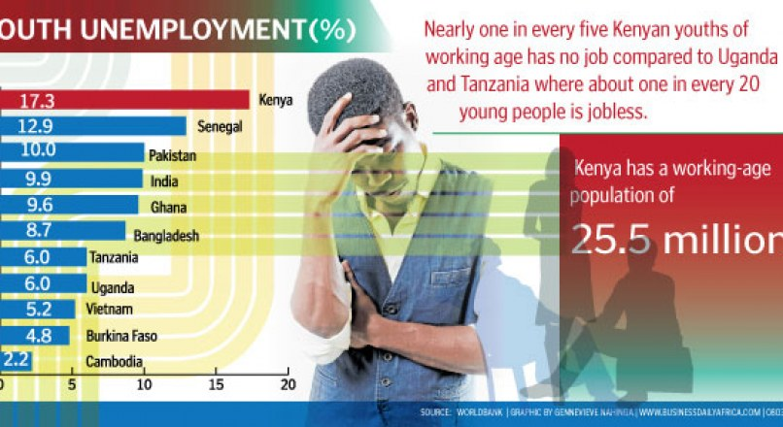


Problem
65% of the youth in Kenya remains unemployed making one of every five youth unemployment.
Therefore we aim to eradicate poverty, promote entrepreneurship and create jobs.

Slide 4
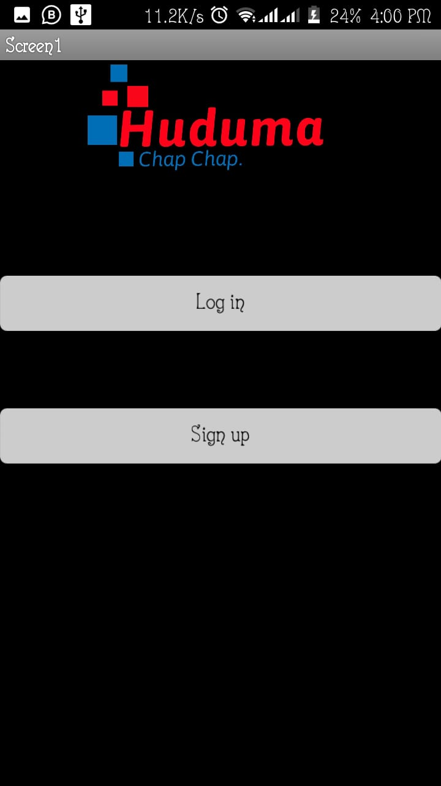
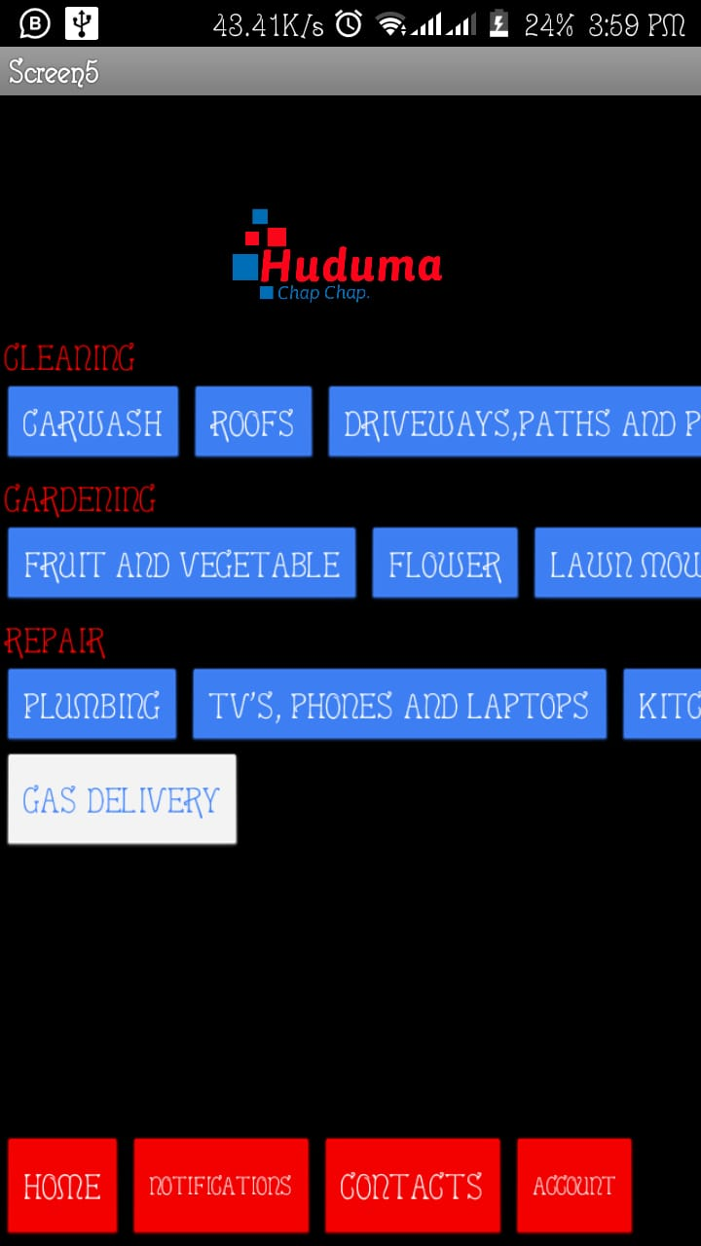
Solution
We came up with an app that links service providers with prospective customers.
Services: cleaning, electronic repair, gardening and gas delivery

Slide 5
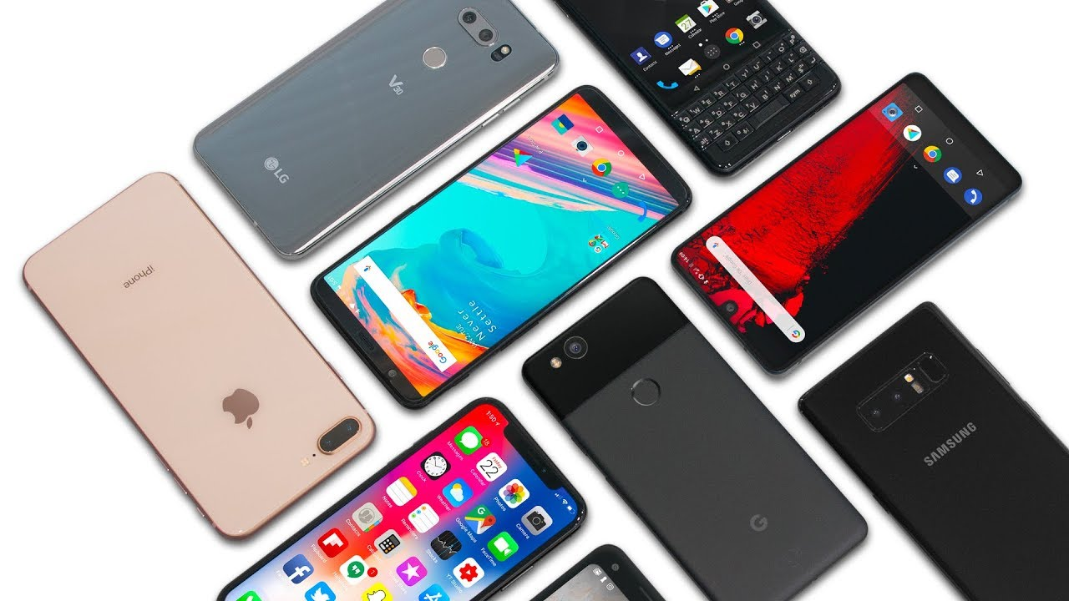
Market
52 million Kenyans own Smartphones and 43 million are internet users.
Why then not link service providers with customers?

Slide 6

Competitors
Lynk - they do not guarantee any follow up
FundiChapChap - they focus specifically on repair services.
Kazi - they do not offer domestic services such as cleaning

Slide 7
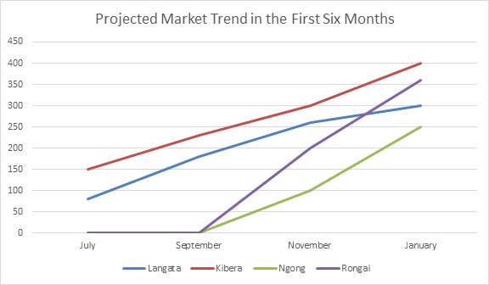
Financial Plan
Earn income through registration fees, 3% transaction charges, advertisements and premium features.

Slide 8

Future?
Expand beyond Kenyan border
Increase variety of services offered
Make our app available in new market; iOS.

Slide 9

Conclusion
TOGETHER WE CAN MAKE AN IMPACT

